Slide 1
Enhancing the Security of Data Transmission in Networks by Integrating Error Correction Mechanisms with Advanced Cryptographic Protocols
Group Members: Tanmay Manoj Wani (21BCE5126)
Patel Smit Mineshkumar (21BCE5597)
Khadadiya Chinkal Mukeshkumar (21BCE5548)
Guide: Dr. Punitha K.

Slide 2
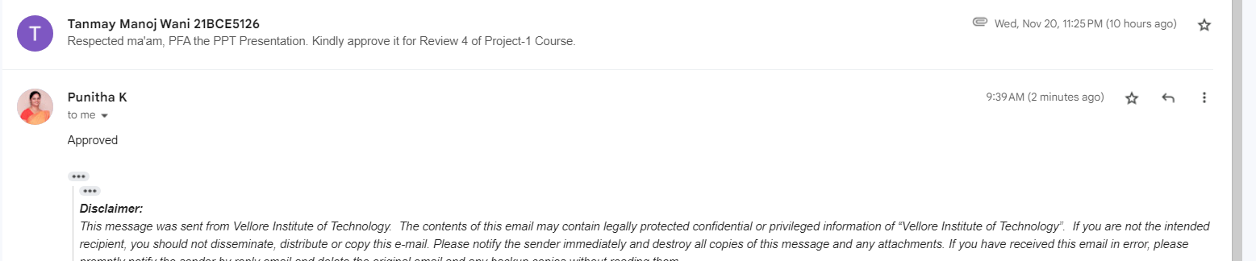
Guide Approval Proof

Slide 3
Introduction - Importance of Secure Data Transmission
Essential Role of Data Transmission:
Vital in sectors like finance, healthcare, government, and entertainment.
Supports applications such as secure messaging, video streaming, and remote data access.
Key Challenges in Network Communication:
Error Susceptibility: Data can become corrupted due to noise, interference, or network issues.
Security Risks: Sensitive data is at risk of interception, unauthorized access, and tampering during transmission.
Growing Demand for Security:
A need for solutions that ensure data integrity (accuracy) and data confidentiality (protection against unauthorized access).

Slide 4
Introduction - Project Overview and Goals
Project Overview:
Combines Reed-Solomon error correction with AES-GCM and RSA encryption protocols to create a secure data transmission model.
Primary Goals:
Data Integrity: Apply error correction to detect and fix errors, improving reliability.
Data Confidentiality: Use encryption to protect data from unauthorized access.
Performance Optimization: Achieve a balance between security, overhead, and latency.
Real-World Impact:
Aims to provide a high-security solution suitable for small scale networks such as ZigBee Network or Intranet networks.

Slide 5
Problem Statement
Data Vulnerability in Transmission:
Data transmitted over networks is susceptible to errors (e.g., noise, interference) and security threats (e.g., interception, unauthorized access).
Challenges with Existing Solutions:
Many current approaches focus on either encryption or error correction alone, which can leave data exposed to integrity or security issues.
Single-layer solutions often struggle to balance security and performance, leading to higher latency or computational overhead.
The aforementioned problems are the source for our problem statement: "Design a hybrid model to enhance data transmission security and integrity by combining error correction and cryptographic protocols for smaller networks."

Slide 6
Research Objectives
Objective 1: Enhance Data Integrity
Implement error correction using Reed-Solomon codes to detect and correct transmission errors, ensuring the accuracy and completeness of data.
Objective 2: Strengthen Data Confidentiality
Apply advanced cryptographic protocols like AES-GCM for secure data encryption and RSA-OAEP for key management, protecting data from unauthorized access.
Objective 3: Optimize Performance
Balance security measures with performance metrics by evaluating encryption/decryption time, Bit Error Rate (BER), Frame Error Rate (FER), and computational overhead.
Objective 4: Develop a Scalable Security Model
Create a hybrid system adaptable for diverse applications (e.g., finance, healthcare, satellite communications) where data security and reliability are critical.

Slide 7
Proposed System - Introduction
Hybrid Approach for Data Security:
Combines error correction and encryption techniques to secure data transmission.
Error Correction with Reed-Solomon Codes:
Reed-Solomon codes add redundancy to the data, allowing for detection and correction of transmission errors, thereby enhancing data integrity.
Encryption Using Advanced Cryptographic Protocols:
AES (Advanced Encryption Standard): A widely used symmetric encryption algorithm that provides data confidentiality.
GCM (Galois/Counter Mode): An encryption mode that combines counter mode for encryption with the Galois field-based message authentication for integrity and authenticity.
AES-GCM provides both confidentiality and integrity in a single pass, making it efficient and secure for data transmission.
RSA (Rivest–Shamir–Adleman): A public-key encryption algorithm used for secure data transmission.
OAEP (Optimal Asymmetric Encryption Padding): A padding scheme used with RSA that enhances its security by preventing certain cryptographic attacks.
RSA-OAEP is widely used in secure data transmission protocols as it provides enhanced security against chosen-ciphertext attacks by adding randomness and structure to the plaintext before encryption.

Slide 8
System Workflow:
Data is first encoded with Reed-Solomon for error correction, then encrypted with AES or RSA protocols before transmission.
At the receiver’s end, data is decrypted and decoded to correct any errors that may have occurred.
Benefits of the Proposed System:
Achieves a high level of data security by combining the strengths of error correction and encryption.
Provides a robust and efficient solution for secure data transmission in error-prone and high-security environments.

Slide 9
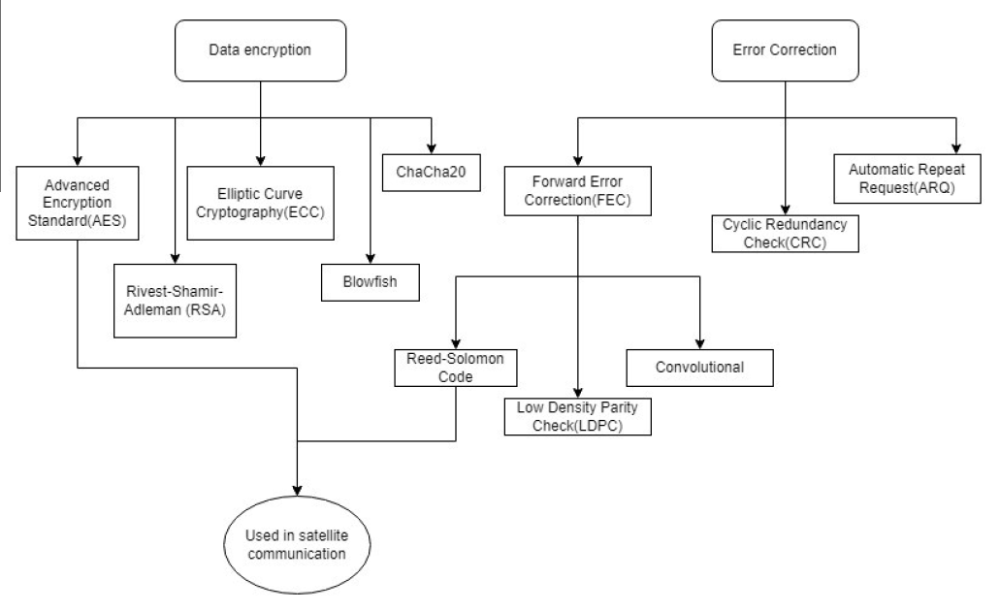
Proposed System Diagram

Slide 10
List of Modules
Data Preparation: Generate test data files and prepare for encryption.
Error Correction: Apply Reed-Solomon coding for error detection and correction.
Encryption: Encrypt data using AES-GCM or RSA-OAEP.
Decryption and Decoding: Decrypt and decode to recover original data.
Performance Analysis: Measure encryption/decryption time, BER, FER, and overhead.

Slide 11
Module 1 - Data Preparation
Objective: Generate test data and simulate real-world conditions for secure transmission.
Steps:
Data Generation: Use randomly generated data files (e.g., 0.5GB and 1GB) to simulate large data transfers and assess system performance.
Data Conversion: Convert data into a format suitable for applying error correction and encryption protocols.
Checksum Calculation: Generate a checksum using SHA-256 to verify data integrity before and after transmission.
Purpose:
Prepare data for transmission and establish a baseline for detecting errors by comparing the checksum pre- and post-transmission.

Slide 12
Module 2 - Error Correction
Objective: Improve data integrity by detecting and correcting errors using Reed-Solomon codes.
Key Steps:
Encoding with Reed-Solomon: Apply Reed-Solomon codes to add redundancy to the data, which helps detect and correct bit-level errors.
Decoding Process: Decode the received data to correct any errors that occurred during transmission.
Error Metrics: Track Bit Error Rate (BER) and Frame Error Rate (FER) to measure the system’s error correction effectiveness.
Implementation:
Functions Used: add_reed_solomon_error_correction for encoding and remove_reed_solomon_error_correction for decoding.
Benefits:
Ensures data integrity even in noisy transmission environments by correcting corrupted bits before decryption.

Slide 13
Module 3 - Encryption with AES-GCM
Objective: Secure data with AES-GCM, providing both encryption and authentication.
Key Steps:
AES Key Generation: Generate a random 256-bit symmetric key for AES encryption.
GCM Mode: AES-GCM (Galois/Counter Mode) ensures data confidentiality and integrity by generating an authentication tag alongside the ciphertext.
Associated Data Authentication: Authenticates associated data to prevent tampering without the need for decryption.
Implementation:
Functions Used: aes_gcm_authenticated_encryption for encrypting data and aes_gcm_authenticated_decryption for decryption and verification.
Advantages:
Efficiency: AES-GCM is a fast and secure encryption method ideal for bulk data encryption.
Data Integrity: Authentication tag protects against tampering, ensuring the data remains intact during transmission.

Slide 14
Module 4 - Encryption with RSA-OAEP
Objective: Secure key exchange using RSA with OAEP padding, which adds a layer of protection against certain cryptographic attacks.
Key Steps:
RSA Key Pair Generation: Generate an RSA key pair (public and private keys) for secure transmission of the AES key.
Key Encryption with OAEP: Encrypt the AES key with RSA-OAEP (Optimal Asymmetric Encryption Padding) to securely send it to the receiver.
Decryption Process: At the receiver’s end, decrypt the AES key using the RSA private key.
Implementation:
Functions Used: hybrid_encrypt to encrypt the AES key with RSA-OAEP and hybrid_decrypt to decrypt it.
Advantages:
Secure Key Exchange: RSA-OAEP allows safe sharing of symmetric keys for AES encryption, combining the strength of asymmetric encryption with the efficiency of symmetric encryption.
Resilience Against Attacks: OAEP padding provides additional security by reducing vulnerability to attacks that target plain RSA encryption.

Slide 15
Reed-Solomon Error Correction
Objectives:
Ensure reliable data transmission over noisy or unreliable channels.
Correct burst errors and recover original data with minimal loss.
Enhance data integrity in digital communication and storage systems.
Key Steps:
Encoding:
Represent data as polynomials over a finite field (Galois Field).
Compute and append parity symbols to the data using polynomial division.
Transmission:
Send the encoded message, including data and parity symbols.
Decoding:
Detect and locate errors in the received message.
Correct errors using algorithms like Berlekamp-Massey or Euclidean.
Error Correction:
Replace corrupted symbols with corrected values to reconstruct the original data.

Slide 16
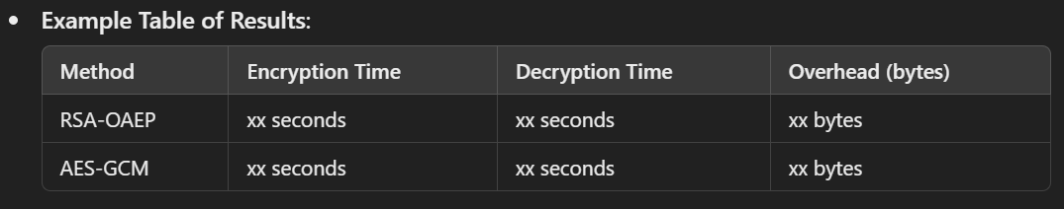
Implementation Overview and Initial Metrics
Overview of Implementation:
The system is built using Python, with three main scripts handling RSA-OAEP, AES-GCM encryption, and Reed-Solomon error correction.
Test Data: Randomly generated data files of 0.5GB and 1GB to simulate large data transmission.
Testing Environment:
Encryption and error correction implemented on sample data to measure system performance.
Simulated network conditions include intentional data corruption to test the effectiveness of error correction.
Initial Metrics:
Encryption Time: Time taken to encrypt data using both AES-GCM and RSA-OAEP.
Decryption Time: Time to decrypt and verify data integrity.
Overhead: Bytes added by Reed-Solomon coding and encryption for each method.

Slide 17
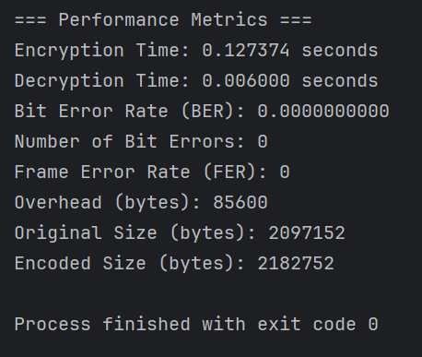
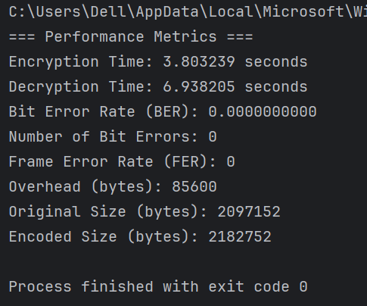
Result Output for different data-size
2MB data
RS,AES&RSA-OAEP Script
RS,AES-GCM Script

Slide 18
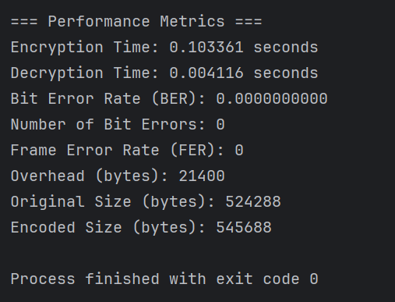
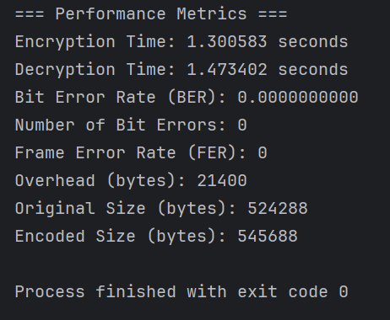
512KB data
RS,AES&RSA-OAEP Script
RS,AES-GCM Script

Slide 19
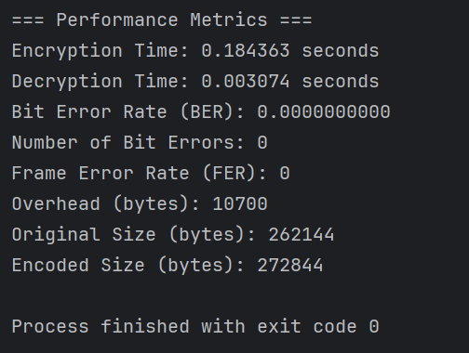
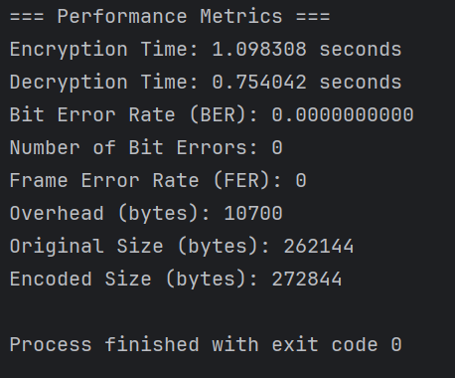
256KB data
RS,AES&RSA-OAEP Script
RS,AES-GCM Script

Slide 20
Error Correction - Bit Error Rate (BER) and Frame Error Rate (FER) Analysis
Objective: Assess error correction efficiency using Reed-Solomon codes with encryption.
Results Summary:
Bit Error Rate (BER): Measures the rate of individual bit errors; lower BER indicates effective error correction.
Frame Error Rate (FER): Measures the rate of entire frames with errors; reduced FER improves data reliability.
Observations:
Combination of Reed-Solomon with AES-GCM achieves lower BER and FER, enhancing data reliability.
Trade-off: Higher computational cost due to the dual-layer processing of error correction and encryption.
Interpretation:
Reed-Solomon + AES-GCM is more suitable for applications needing high data integrity despite a slight performance cost.

Slide 21
Performance Analysis - Overhead, Latency, and Findings
Objective: Evaluate performance impacts, including latency and computational overhead.
Results Summary:
Overhead: Bytes added due to error correction and encryption. Reed-Solomon increases data size for error correction but improves reliability.
Latency: Time delay introduced due to combined encryption and error correction steps.
Findings:
AES-GCM: Low latency, suitable for real-time applications, though it has slightly higher overhead.
RSA-OAEP: Adds more latency but offers secure key management for cases requiring asymmetric encryption.
Interpretation:
AES-GCM + Reed-Solomon: Ideal for high-speed, reliable data transmission.
RSA-OAEP + Reed-Solomon: Effective for scenarios needing secure key exchange with added resilience.
Conclusion:
Both methods show potential, with AES-GCM preferred for efficiency and RSA-OAEP for secure key distribution, each balancing security and performance differently.

Slide 22
References
Forouzan, B.A. Data Communications and Networking. McGraw-Hill, 2007.
Stallings, W. Data and Computer Communications. Pearson, 2017.
Couvreur, A., Lequesne, M. "On the Security of Subspace Subcodes of Reed–Solomon Codes for Public Key Encryption." IEEE Transactions on Information Theory, vol. 68, no. 1, 2021.
D. Purwanto, "Optimization of Data Security System Control with CRC (Cyclic Redundancy Check) Algorithm." Budapest International Research and Critics Institute-Journal, vol. 4, no. 3, 2021.
5.Chen, Z., Yin, L., Pei, Y., Lu, J. "CodeHop: Physical Layer Error Correction and Encryption with LDPC-Based Code Hopping." Science China Information Sciences, vol. 59, 2016.
6.Dener, M., Bay, O.F. "TeenySec: A New Data Link Layer Security Protocol for WSNs." Security and Communication Networks, vol. 9, 2016.
7. Bertino, E. "Data Security and Privacy Concepts." IEEE COMPSAC, 2016. doi:10.1109/COMPSAC.2016.89.
8.Reed-Solomon Codes and Applications. Retrieved from National Institute of Standards and Technology.
9.RSA Laboratories. Public-Key Cryptography Standards (PKCS) #1 v2.2: RSA Cryptography Specifications. 2012.
10.National Institute of Standards and Technology (NIST). Recommendation for Block Cipher Modes of Operation: Galois/Counter Mode (GCM) and GMAC. NIST Special Publication 800-38D, 2007.

